Slide 1

Solar Way (Electro)
EMPOWERING A SUSTAINABLE FUTURE THROUGH RENEWABLE ENERGY
Netaji Subhas University of Technology

Slide 2

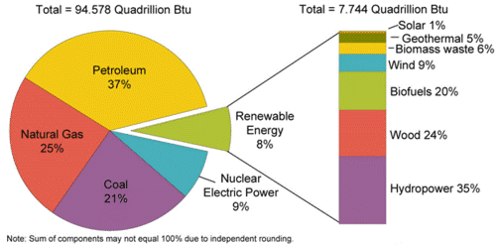
The Current Energy Product Method
The major of total energy is still produced by the non-renewable source.
This is one of the prime problem of Climate Change.
We need to shift from non-renewable energy to renewable energy.

Slide 3

What is Our Solution
We are providing the installation service of solar panel with a pre-define contract between our company
We have wright to utilize the power of 50% of initial system capacity
User can get excess electricity at cheaper cost.

Slide 4
How our system Work
Energy Generated
50% Utilize by them self.
Provide to neighbors or back feed at cheap price
Excess Energy is supply to Grid at standard rates.

Slide 5

The Major Problem in current Home Solar System Installation.
The initial cost of Solar Systems very high.
People who want to install Solar System avoid the installation due to cost.
The government 40% subsidy for encouraging people to install solar is not enough for general household.

Slide 6

Our Key Features.
Hassle-free Installing
Minimum Paperwork
System Installed for user will be 70-75% of cheaper than initial price.
Provide electricity 24/7*

Slide 7

Our Solution will prevent
Another incident of 31 July 2012,largest power outage in history. The outage affected more than 620 million people, about 9% of the world population, or half of India's population, spread across 22 states in Northern, Eastern, and Northeast India. An estimated 32 gigawatts of generating capacity was taken offline.
Excess Stress in our main grid.

Slide 8

